Slide 1
Fitting Methods in Nuclear Physics
Amy Lovell
Final Project for Computational Physics
April 30, 2015
Notes:
Good afternoon. Today I’ll be telling you about my final project, minimization to fit nuclear scattering data.

Slide 2
Outline
Physics Motivation
Description of Minimization Routine
Results
Conclusion and Future Work
Notes:
Before I begin, I’d like to give you a bit of a road map. I’ll start with some motivation as to why we fit data at all, and then describe the minimization technique that I used. Finally I will show you the results of my calculations before concluding.

Slide 3
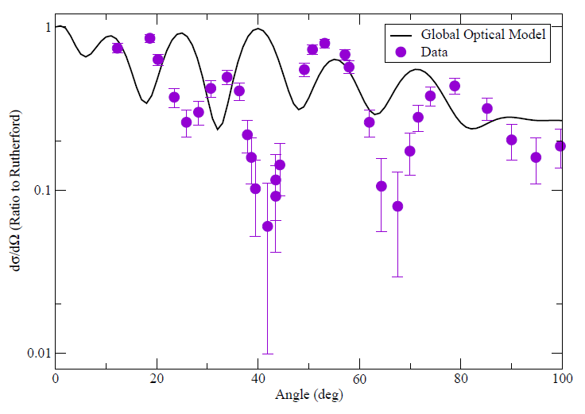
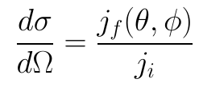
Connecting Theory to Observables: Differential Cross Sections
⁴⁸Ca(d,d)⁴⁸Ca
@ 23.2 MeV
I.J. Thompson and F.M. Nunes, Nuclear Reactions for Astrophysics, Cambridge University Press, Cambridge, 2009
J.M. Lohr and W. Haeberli, Nucl. Phys. A 232 381 (1974)
M. Ermer, et. al., Nucl. Phys. A 533 71 (1991)
Notes:
In nuclear physics, one of the ways we connect theory and experiment is through differential cross sections, which is simply defined as the outgoing flux from a reaction divided by the incoming flux. One such example is shown here, for 48Ca-deuteron elastic scattering at 23.2 MeV – which is the example I will be using throughout my presentation. This shows the differential cross section – as a ratio to the Rutherford cross section – as a function of angle. The solid black line is the calculated cross section, in comparison to the purple data.

Slide 4
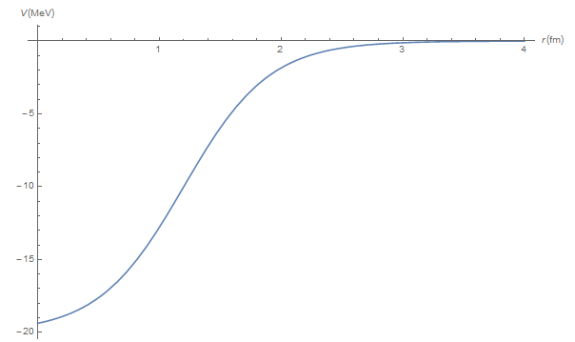

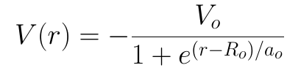
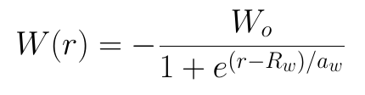
Optical Model
Three types of potentials:
Volume, Surface, Spin-orbit
➔ 18 parameters to fit!
I.J. Thompson and F.M. Nunes, Nuclear Reactions for Astrophysics, Cambridge University Press, Cambridge, 2009
Notes:
To calculate a cross section, we need a model for the potential between the nuclei. One that is often used is the Optical Model. Here, our potential contains both a real and an imaginary part. The imaginary party describes the flux going to channels that are not explicitly in our model. Often we take a Woods-Saxon shape or the derivative of a Woods-Saxon for our potentials – an example of which is shown here. Each WS has three parameters, a depth, radius, and diffuseness. With three types of potentials – volume, surface, and spin-orbit, this gives us potentially 18 parameters in our model. It gets a little better than this, because several of these terms are often zero, so we typically have 12 free parameters.

Slide 5
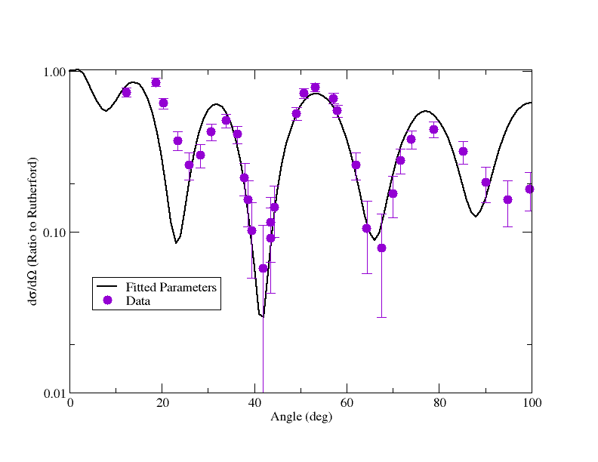
Fit to Elastic Scattering Data
J.M. Lohr and W. Haeberli, Nucl. Phys. A 232 381 (1974)
M. Ermer, et. al., Nucl. Phys. A 533 71 (1991)
Notes:
We constrain these parameters by fitting them to elastic scattering data. One such example is shown here, the original parameterization is shown on the left and the fitted parameterization on the right.

Slide 6
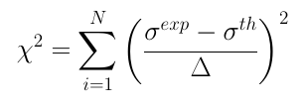

Chi Square Minimization
I.J. Thompson and F.M. Nunes, Nuclear Reactions for Astrophysics, Cambridge University Press, Cambridge, 2009
Notes:
Fitting can be done through a chi square minimization, where the chi square is the sum of the squares of the difference between the experimental data points and the theory points weighted by the experimental error. The goal is to have a chi square per degree of freedom of one.

Slide 7
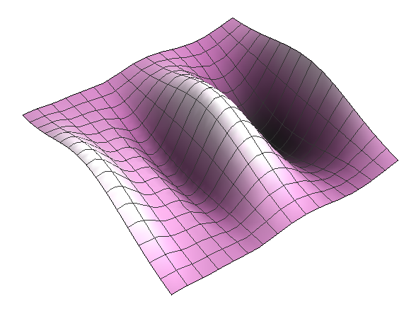
Gradient Descent
Take a step in parameter space in the direction that minimizes the function of interest
Finds a local minimum
No way to “hop” over hills
G. Arfkan, Mathematical Methods for Physics, 3rd Edition, Academic Press, Orlando, 1985
Notes:
The technique that I used for my project is gradient descent. We take a step in parameter space down the gradient in order to minimize our function of interest, in this case, the chi square value. This is a very simple method: it only finds a local minimum, because it has no way to basis hop – or examine the parameter space to see if there are multiple minima.

Slide 8
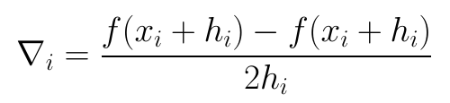


The Algorithm
Calculate chi square value at parameter set x_{i}
Calculate the gradient at x_{i}
Update parameters
Calculate chi square value at parameter set x_{i+1}
Repeat procedure until some condition is met
Notes:
The algorithm works as follows: the chi square value is calculated at the original parameter set. The gradient at that point is calculated, using the central difference formula. The parameters are updated by subtracting the gradient multiplied by a step size. Finally, the chi square value is calculated again. The steps in blue are repeated until some condition is met – in this case the difference between the current chi square and the previous chi square have to be less than some value, delta.

Slide 9
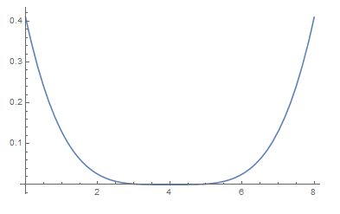
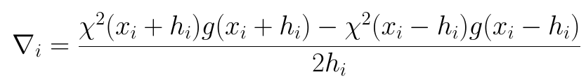
Details: Physical Parameter Ranges
Introduce a penalty function, g(x)
Weight the gradient:
10 ≤ V ≤ 170 MeV
0.7 ≤ r ≤ 1.5 fm
0.4 ≤ a ≤ 0.8 fm
(very generous ranges)
Notes:
There is one detail that we have to be a little careful of. The parameters have a range of physical values that they have to stay within. An example is given here, with very, very generous parameter ranges. Typically, they’d be much tighter than this. To make sure that we stay within our parameter range, we introduce a penalty function, which would confine the parameter. This would be used to weigh the gradient so that outside of the parameter range, the gradient would be larger and therefore, take a larger step in towards a physical parameter value.

Slide 10
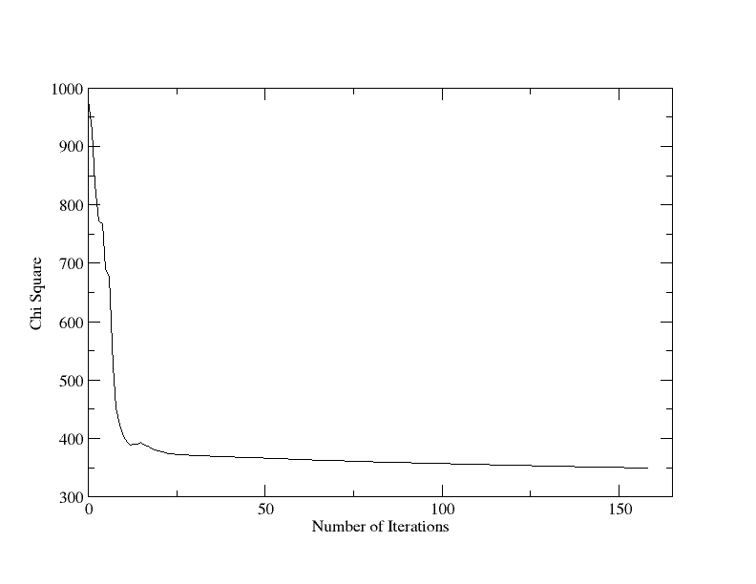

Penalty Function: None
V=103.2059 MeV
r=0.7709 fm
a=0.5852 fm
Ws=15.9270 MeV
rs=0.5584 fm
as=1.1680 fm
158 steps
Notes:
There are many different functions that we could try for this. In the following few slides, I show some of the ones that I investigated, but first, for comparison, here’s the minimization with no penalty function. Here are the parameters that were reached, and the plot shows the chi square value as a function of the number of iterations. We can see that many of these parameters are not physical – especially the radii and this imaginary diffuseness.

Slide 11
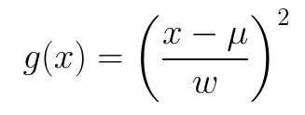
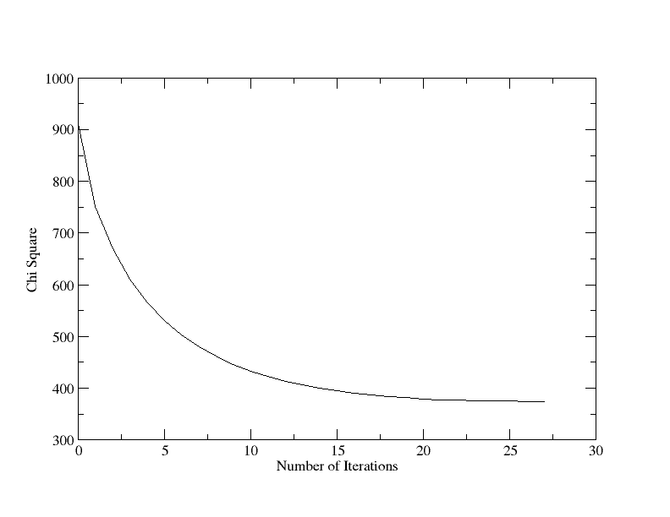

Penalty Function: Parabola
V=103.2389 MeV
r=1.0876 fm
a=0.6014 fm
Ws=16.6778 MeV
rs=1.1689 fm
as=0.3000 fm
27 steps
Notes:
Here, the penalty function was a parabola – with a mean value mu and weight w for each parameter. It has a slightly higher chi square than the previous iteration, but all of the parameters stay within their physical ranges.

Slide 12
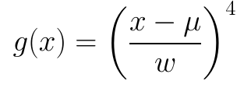
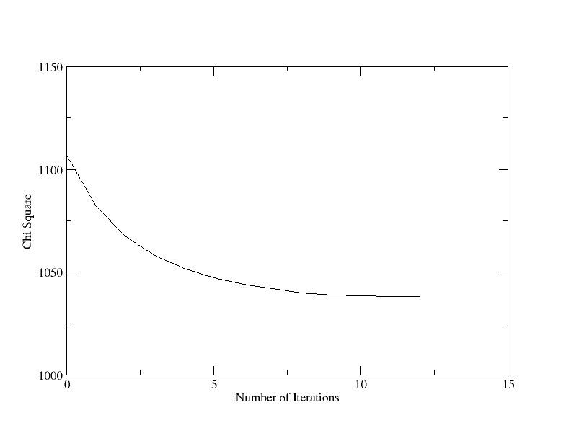

Penalty Function: Parabola Squared
V=103.2068 MeV
r=1.0501 fm
a=0.7408 fm
Ws=18.8142 MeV
rs=1.3878 fm
as=0.3978 fm
12 steps
Notes:
I explored a parabola squared as well. One of the benefits to this would be that it’s flatter along the bottom so the parameters should be less weighted toward the center of the distribution.

Slide 13

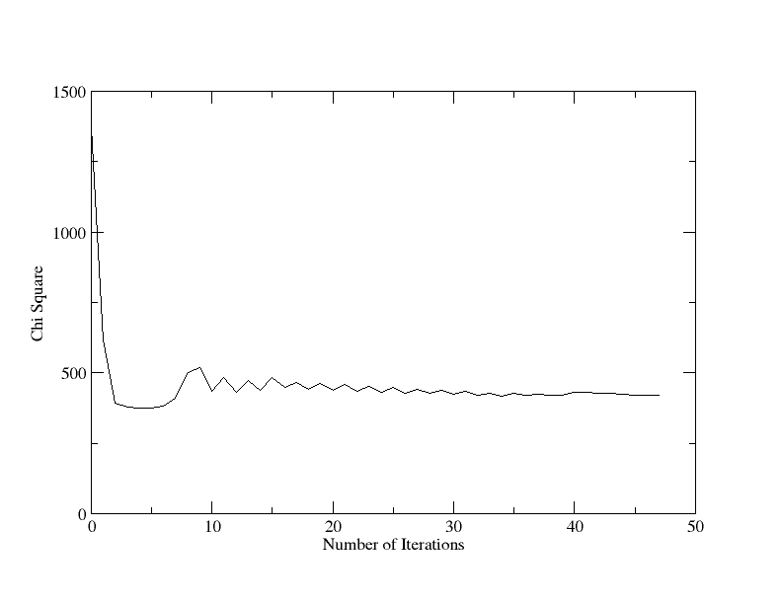

Penalty Function: Gaussian
V=103.2231 MeV
r=1.1001 fm
a=0.6751 fm
Ws=16.4784 MeV
rs=1.0980 fm
as=1.4804 fm
47 steps
Notes:
We can also look at a Gaussian-form, as given here. This was something like the form I had first considered, since it’s very straight forward to define a mean value and a width of a distribution with a Gaussian. However, we can see that it is easier for the parameters to go outside of the physical range (as).

Slide 14
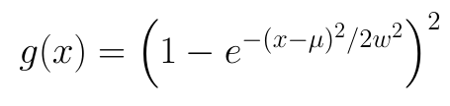
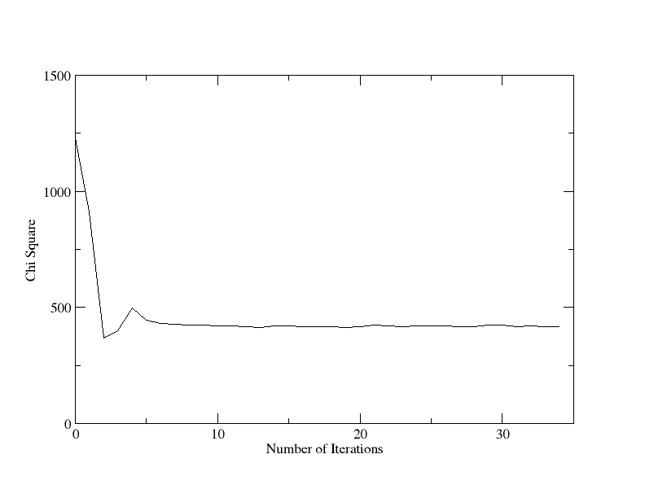

Penalty Function: Gaussian Squared
V=103.2018 MeV
r=1.0890 fm
a=0.6224 fm
Ws=16.5337 MeV
rs=1.4432 fm
as=1.4643 fm
34 steps
Notes:
We can also use higher order Gaussian forms – which again flattens out the bottom of the well. I ended up using the parabola, since it gave the lowest chi square and kept the parameters within a physical range.

Slide 15
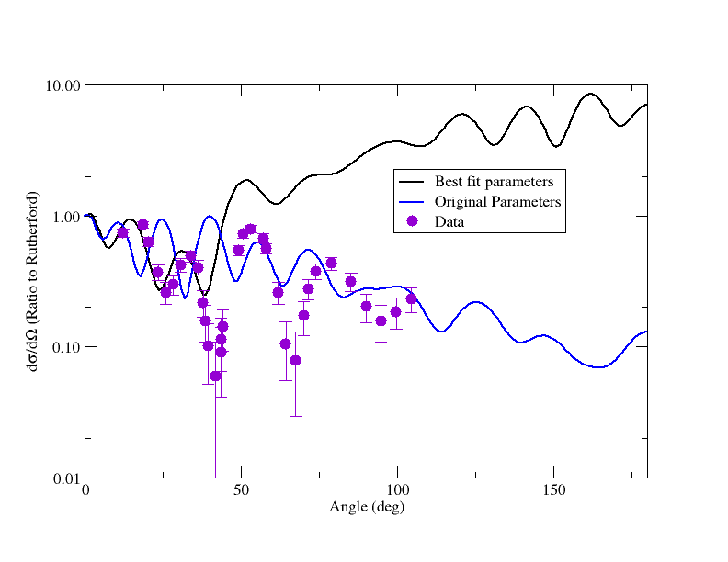
Minimization and Comparison to Data
J.M. Lohr and W. Haeberli, Nucl. Phys. A 232 381 (1974)
M. Ermer, et. al., Nucl. Phys. A 533 71 (1991)
Notes:
Here are my results. This is again, the elastic scattering differential cross section – as a ratio to Rutherford cross section- as a function of the angle. The black line is the calculation with the parameters from my minimization, compared to the blue line which are the original parameters. Both compared to the data. My minimization fits the data very well at low angles, and although it is above the data at higher angles, it still does a better job of matching the peaks and valleys than the original parameterization.

Slide 16
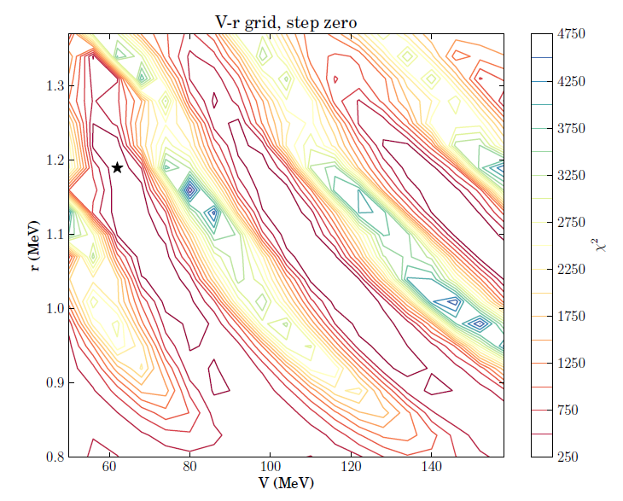
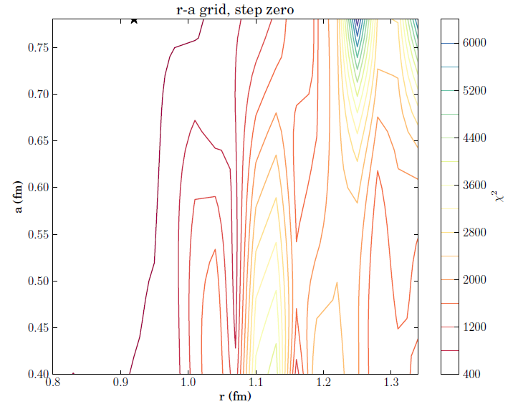

Complicated Parameter Space
Notes:
One of the other things I had been interested in exploring for this project was finding multiple minima in the parameter space. To do this, I took slices of the parameter space – where all of the parameters would be held constant while two were allowed to vary. Such as shown here, a depth and diffuseness for the real volume term. The star shows the absolute minimum in the space I’m considering. So we have a minimum, it’s about at 1.2 fm in r; then we can look at r compared to another variable to see if we see a minimum at r=1.2. We don’t. The minimum is on the edge of the parameter space, which isn’t good, and it doesn’t even look like there’s a local minimum near our region of interest. I looked at 165 of these plots, and this was the general trend. This is a complicated problem, and fitting is not straight forward.

Slide 17
Conclusion and Future Work
Constructed a down-hill gradient minimization routine
Implement more advanced minimization techniques
Basin hop to look for multiple minima in one pass
Investigated different penalty functions to keep parameters in a physical range
Evaluated slices of parameter space to look for multiple minima
Parameter space is very complicated, minima are not straight forward to find
Notes:
In conclusion, I have constructed a down-hill gradient minimization routine. With more time, it would be much more interesting to implement more advanced minimization techniques, or even do something like basis hopping to look for multiple minima in one pass. I investigated different penalty functions to keep the parameters in a physical range. Finally, I investigated slices of parameter space to try and find multiple minima, which lead to the confirmation of having a very complicated parameter space.

Slide 18
Thank you
Any Questions?
Notes:
I’d like to thank especially Phil and Jenni for all of their insight and discussions during this project, as well as all of you for listening. Any questions?

